Slide 1
Azure Workshop
Azure Fundamentals – Day 2

Slide 2

Instructor
Mohd Mishal
Clouds Solution Architect
MCT since 2006
MCSA, MCSE, MCITP, MCSA
Azure, SCCM, O365
Computer Engineer UIUC

Slide 3
Workshop Schedule
Day 2
Web Apps
Site Recovery and Back Up
Active Directory in Azure
Diving Deep into Azure

Slide 4
Agenda
Time | Topic
8:30 AM | Registration and Breakfast
8:45 AM | Welcome remarks
9:00 AM | Introduction to Cloud
9:15 AM
10:15 AM | Compute Instances
10:30 AM
11:30 AM | Virtual Networks
12:30 PM | Platform as a Service Virtual Machines
1:30 PM
2:45 PM
4:00 PM

Slide 5
Web Apps

Slide 6
Creating and configuring web apps
Web Apps as a component of Azure App Service Comparing the Web Apps feature, Azure VMs hosting web sites, and Azure Cloud Services Creating and maintaining web apps Configuring and scaling web apps Demonstration: Creating and configuring a web app
Notes:
10979D
4: Web Apps and cloud services

Slide 7
Web Apps as a component of Azure App Service
App Service:
Web Apps
Mobile Apps
API Apps
Logic Apps
Web Apps features:
Marketplace-based solutions
Autoscaling
Continuous integration
Deployment slots
Azure WebJobs
Hybrid connections
Notes:
Describe the types of App Service apps and summarize the most prominent features of Web Apps.
10979D
4: Web Apps and cloud services

Slide 8
Web Apps
Web Apps concepts:
Gallery applications
Autoscaling
Continuous integration and deployment
Deployment slots
Testing in production
Azure WebJobs
Hybrid connections
Azure virtual network integration
Authentication and authorization
Notes:
Provide an overview of the Web Apps feature of App Service. Explain that later lessons provide more detail about web apps.
20533D
5: Implementing Azure App Service

Slide 9
Mobile Apps
Requirements of mobile apps:
Store and access structured data
Receive notifications for alerts and updates
Authenticate and authorize
Incorporate business logic
Mobile Apps is not the same as Azure Mobile Services
You can move mobile apps from Mobile Services to Mobile Apps by using:
Migration
Upgrade
Notes:
Emphasize that the goal of that integration is to allow developers to use the same tools and platforms to develop mobile apps and web apps. Additionally, point out that Lesson 6 covers Mobile Apps in detail.
20533D
5: Implementing Azure App Service

Slide 10
Logic Apps
Logic apps integrate apps by using connectors:
Core connectors:
Office 365 Connector
Microsoft OneDrive Connector
Yammer Connector
Facebook Connector
HTTP Connector
Enterprise integration connectors:
SAP
Oracle
DB2
Informix
Notes:
If time permits, demonstrate how to create a logic app. Explain that developers can implement their own application programming interfaces (APIs) and develop solutions that will integrate with cloud-based apps.
20533D
5: Implementing Azure App Service

Slide 11
API Apps
Features of API Apps:
Visual Studio integration
Consumption model
Bring your existing API
Support for Swagger metadata
Support for cross-origin resource sharing
Triggering actions
Notes:
Describe the main components of the API Apps feature of Azure App Service.
20533D
5: Implementing Azure App Service

Slide 12
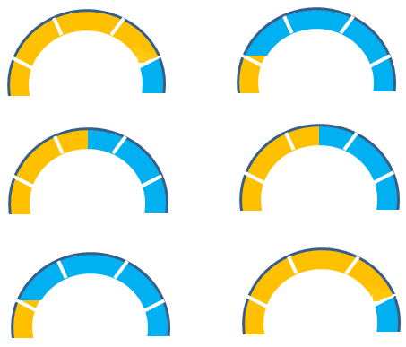
Comparing the Web Apps feature, Azure VMs hosting web sites, and Azure Cloud Services
If you want to host a web application in Microsoft Azure, you can choose to use virtual machines, web apps, or cloud services
Ease of use Control
- + - +
- + - +
- + - +
Web Apps
Cloud Services
Virtual Machines
Notes:
Describe the differences between web apps, cloud services, and virtual machines.
10979D
4: Web Apps and cloud services

Slide 13
Managing App Service plans
Tier | Free | Shared | Basic | Standard | Premium | Premium V2 | Isolated
Websites | 10 | 100 | Unlimited | Unlimited | Unlimited | Unlimited | Unlimited
Storage | 1 GB | 1 GB | 10 GB | 50 GB | 250 GB | 250 GB | 1 TB
Compute instance | Shared | Shared | Dedicated | Dedicated | Dedicated | Dedicated | Dedicated
Custom domains | No | Yes | Yes | Yes | Yes | Yes | Yes
SSL for custom domains | No | No | Yes | Yes | Yes | Yes | Yes
Integrated load balancer | No | Yes | Yes | Yes | Yes | Yes | Yes
AlwaysOn | No | No | Yes | Yes | Yes | Yes | Yes
Staged publishing | No | No | No | Yes | Yes | Yes | Yes
SLA | None | None | 99.95% | 99.95% | 99.95% | 99.95% | 99.95%
Notes:
Describe the features of each pricing tier and point out that the features are cumulative, which means that each plan has all the features of the lower tier plan plus additional features.
20533D
5: Implementing Azure App Service

Slide 14
Configuring and scaling web apps
General (frameworks, managed pipeline, platform, web sockets, Always On)
Auto swap
Debugging (VS 2012 and newer)
App settings
Connection strings
Default documents
Handler mappings
Virtual applications and directories
WebJobs
Scaling up: increasing a pricing tier
Scaling out:
Free and Shared. Not supported (but you can scale them up)
Basic. Manual (instance size, instance count)
Standard and Premium. Automatic (instance size, instance count, and autoscaling)
Notes:
Describe the main configuration options of web apps.
10979D
4: Web Apps and cloud services

Slide 15
Implementing WebJobs
WebJobs are scripts that run:
Continuously
Triggered
Scheduled
Manual
WebJobs can be:
Batch files (.cmd, .bat)
PowerShell scripts (.ps1)
Bash shell scripts (.sh)
PHP scripts (.php)
Python scripts (.py)
Node.js JavaScripts (.js)
JavaScript (.jar)
Notes:
Describe different types of WebJobs and different scripting languages that you can use to define their operations.
Point out that is no longer necessary to store scripts in .zip files before uploading them to Azure web apps via the Azure portal.
20533D
5: Implementing Azure App Service

Slide 16
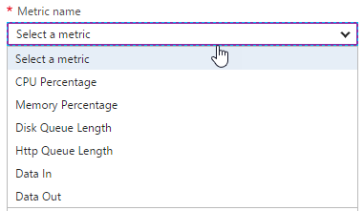
Design for Scalability and Performance
Scale Up – Change pricing tiers: Free, Shared, Basic, Standard, Premium
Scale Out – Change instance count: manually, auto
Scaling condition rules: Scheduled or Metric
Can have multiple condition rules
Can notify via email or webhook when autoscale events occur
Notes:
Design Web Apps for Scalability and Performance
Scale up an app in Azure
https://docs.microsoft.com/en-us/azure/app-service-web/web-sites-scale
Scale instance count manually or automatically
https://docs.microsoft.com/en-us/azure/monitoring-and-diagnostics/insights-how-to-scale?toc=%2fazure%2fapp-service-web%2ftoc.json

Slide 17
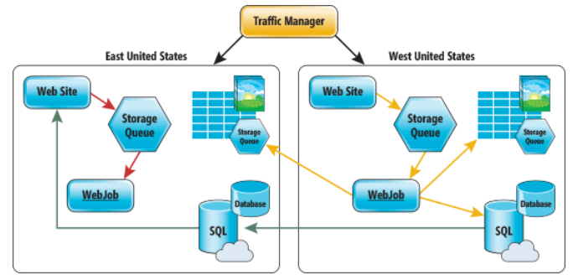
Deploy Azure Web Apps to Multiple Regions
Traffic Manager for routing traffic between regions
Performance – for directing user to closest region Failover – for secondary site Round Robin – for balancing traffic
CDN
Places static content close to user (images, media, etc)
Notes:
Deploy Azure Web Apps to Multiple Regions for High Availability
Controlling Azure web app traffic with Azure Traffic Manager
https://docs.microsoft.com/en-us/azure/app-service-web/web-sites-traffic-manager
Add a Content Delivery Network (CDN) to an Azure App Service
https://docs.microsoft.com/en-us/azure/app-service-web/app-service-web-tutorial-content-delivery-network
Best Practices: Windows Azure Websites (WAWS)
https://azure.microsoft.com/en-us/blog/best-practices-windows-azure-websites-waws/

Slide 18
Using Kudu
Kudu:
Provides Git support for web apps
Runs WebJobs
Implements a diagnostic and troubleshooting user interface
To access the Kudu user interface for a web app, enter https://mysite.scm.azurewebsites.net
In the Kudu user interface, you can:
Run commands
View processes
Access log files
Add extensions
Notes:
The Kudu user interface offers many features that provide access to diagnostics and troubleshooting tools, including:
Process explorer displays all processes within the context of your web app, including WebJobs.
Debug console implements command-line and file browser access to your web app. You can use it to upload files, run Git deployment commands, and edit text files.
20533D
5: Implementing Azure App Service

Slide 19
Creating and configuring a web app
Create a new web app in Azure by using the Azure portal
Browse the new web app
View scaling and configuration options in the Azure portal
Notes:
Review the steps in Lab A: Exercise 1 for guidance when performing this demonstration.
https://github.com/MicrosoftLearning/10979-MicrosoftAzureFundamentals/blob/master/Instructions/10979D_LAB_04.md

Slide 20
Deploying and monitoring web apps
Options for creating and publishing web app content Publishing a web app from Visual Studio Performing staged deployments Monitoring web apps
Notes:
Note: The terms publish and deploy are used throughout this lesson. This note provides clarification of these terms:
Publishing, in the context of this module, is a sequence of tasks that make the web app content available for use. These tasks typically use Microsoft development tools to facilitate content creation and upload.
Deployment, in the context of this module, is used generically to represent a part of the publishing process that facilitates content upload. There are numerous, vendor-agnostic methods to carry out the deployment task, such as File Transfer Protocol (FTP).
Ensure that your students understand this distinction.
Question
What are the benefits of deployment slots, and how can you move your web app between different slots?
Answer
You can create deployments slots for production and development. You can validate the status of your web app in the staging deployment slot and swap it into production after the validation is complete. Furthermore, if it turns out that the newly deployed version of the web app is not functioning properly, you have the flexibility to perform an instant rollback.
10979D
4: Web Apps and cloud services

Slide 21
Options for creating and publishing web app content
To create and publish a web app, you can use:
Microsoft Visual Studio
Visual Studio Team Services
Microsoft WebMatrix
Azure Marketplace
To deploy a web app, you can use:
Web Deploy
Visual Studio
MSDeploy.exe
WebMatrix
New-AzureRmResourceGroupDeployment
FTP
No support for advanced features
Notes:
Describe the different methods of creating, publishing, and deploying Azure web apps. Point out the advantages of using Web Deploy in comparison with FTP.
10979D
4: Web Apps and cloud services

Slide 22
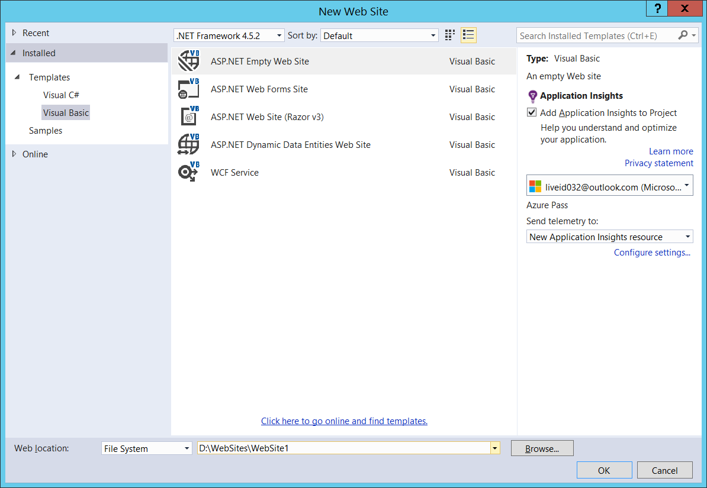
Publishing a web app from Visual Studio
Notes:
Consider demonstrating the process of using Visual Studio to create and publish a web app. If you decide to do this, you can publish the web app that you created in the previous demonstration.
10979D
4: Web Apps and cloud services

Slide 23
Performing staged deployments
Deploy updates by using:
FTP
Web Deploy
Continuous deployment:
Connect a project to a web app in Azure
Check in the changes
Build and deploy automatically to a staging slot
Swap to the production slot
Adjust (if needed):
Connection strings
Handler mappings
Monitoring and diagnostic settings
Notes:
Describe methods of deploying updates and performing continuous deployment.
10979D
4: Web Apps and cloud services

Slide 24
Update Web Apps with Minimal Downtime
Deployment Slots are live apps with their own hostnames
Only available for Standard or Premium App Service plans
Number of slots available depend on App Service Plan
App content and configurations can be swapped between two deployment slots
Not all settings and configurations are swapped
Some settings can be marked to not swap
Testing in Production feature allows you to spread traffic across multiple deployment slots
Notes:
Update Azure Web Apps with Minimal Downtime
Set up staging environments in Azure App Service
https://docs.microsoft.com/en-us/azure/app-service-web/web-sites-staged-publishing

Slide 25
What gets Swapped with a Deployment Slot?
Swapped | Not Swapped
App Settings – can be configured to not swap | Custom Domain Names
Connection Strings – can be configured to not swap | SSL certificates and bindings
General settings | Scale settings (only production slots are scalable)
Handler mappings | Publishing endpoints
Diagnostic logs settings

Slide 26
Monitoring web apps
Monitor Azure web apps:
Adding metrics
Configuring alerts
Configure diagnostics:
Web server logging
Detailed error messages
Failed request tracing
Application logging
Store logs:
File system
Azure storage
Notes:
Consider demonstrating the Metric blade in the Azure portal as you present this topic.
10979D
4: Web Apps and cloud services

Slide 27
https://github.com/MicrosoftLearning/10979-MicrosoftAzureFundamentals/blob/master/Instructions/10979D_LAB_04.md
Exercise 1
Estimated Time: 15 minutes

Slide 28

Site Recovery and Back Up

Slide 29
Planning storage
Storage as an Azure component Overview of Azure Storage Planning for standard Azure Storage Planning for Azure Premium Storage
Notes:
20533D
6: Planning and implementing storage, backup, and recovery services

Slide 30
Overview of Azure Storage
Storage types:
Blob storage. Containers for data blobs. The three types of blobs are:
Page blobs:
Optimized for random access
Azure virtual machine disk files
Block blobs:
Optimized for sequential access
Ideal for media and backups
Append blobs:
Optimized for append operations only
Ideal for logging
Table storage. Store for non-relational key/value entities
Queue storage. Temporary store for asynchronous exchange of messages
File storage. File sharing store through SMB 3.x and SMB 2.1
Notes:
Emphasize that a standard storage account represents a namespace that identifies a storage area, which can include blob, table, queue, and file storage for standard storage accounts. Point out that premium storage accounts allow for hosting page blobs only.
This lesson later compares the storage types that Azure Storage supports. The last topic of this lesson covers premium storage accounts in more detail.
20533D
6: Planning and implementing storage, backup, and recovery services

Slide 31
Planning for standard Azure Storage
Blob storage:
Block blobs - variable-sized blocks, optimized for large blobs
Page blob - 512-byte pages, optimized for random read/write
Append blob - specifically for append operations
Table storage:
Stores data as key/value pairs in rows
Row entities or 252 custom properties (columns)
Single clustered index
Queue storage:
Stores inter-application messages
File storage:
SMB 2.1 and SMB 3.x file shares
Notes:
This slide describes the basic capabilities of each storage type:
Blobs:
Use block blobs for applications that need to upload large files to Azure. Block blobs are optimized for fast uploads and high throughput.
Use page blocks for applications that need to read and write data by using random I/O access patterns. For example, Azure VMs use page blobs as their virtual disks.
Tables:
Use tables as a NoSQL store for key/value pair records.
Queues:
Use queues to implement applications that need to exchange asynchronously messages among its components.
Note: Many application developers use the Azure Service Bus service instead of Azure Queue storage.
Files:
Use the Azure File Service to create file shares in Azure storage that users can access by using standard Server Message Block (SMB) semantics from VMs in Azure and from on-premises locations via a site-to-site virtual private network (VPN) or ExpressRoute.
20533D
6: Planning and implementing storage, backup, and recovery services

Slide 32
Planning for Azure Premium Storage
DS or GS virtual machine
Blobcache
RAM cache
Server SSD cache
Azure storage page blobs
Notes:
Point out the main differences between standard and premium storage accounts. In addition note that with Premium Storage, you pay for provisioned capacity rather than used capacity. With standard storage, you pay for used capacity except for scenarios that involve the use of managed disks. Mention that Premium Storage does not incur separate charges for transactional volume.
20533D
6: Planning and implementing storage, backup, and recovery services

Slide 33
Implementing and managing Azure Storage
Creating a storage account Implementing blobs Implementing Azure file storage Implementing Azure table and queue storage Controlling access to storage Monitoring storage Demonstration: Implementing storage
Notes:
20533D
6: Planning and implementing storage, backup, and recovery services

Slide 34
Creating a storage account
General purpose storage accounts:
Blobs (page, block, append), tables, queues, files
Performance
Standard or Premium (page blobs, LRS only)
Replication
LRS, ZRS (block blobs only), GRS, RA-GRS
Blob storage accounts:
Block and append blobs only (optimized pricing)
Access tiers (depending on frequency of data access):
Hot or cool
Switching between tiers is supported (consider cost implications)
Replication:
LRS, GRS, RA-GRS
Notes:
Describe the different types of accounts and their characteristics.
20533D
6: Planning and implementing storage, backup, and recovery services

Slide 35
Implementing blobs
Create a container in a storage account
Specify an access level:
Private
Public Blob
Public Container
Manage by using:
AzCopy
Azure Storage Explorer
Azure PowerShell
Azure CLI
Azure portal
Notes:
Describe the different methods of managing blobs and containers.
20533D
6: Planning and implementing storage, backup, and recovery services

Slide 36
Implementing Azure file storage
Creating file shares:
Azure portal, Windows PowerShell, Azure CLI, or REST API
Accessing file shares:
On Windows, create a drive mapping with the net use
On Linux, create a mountpoint and run mount –t cifs
Provide an account name and a key
Run from the same region (SMB 2.1 or SMB 3.x)
Run from another Azure region or from any on-premises location (SMB 3.x on Windows)
Alternatively, use Windows PowerShell, Azure CLI, AzCopy, or the REST API from any location
Notes:
Describe how to manage and access file shares.
20533D
6: Planning and implementing storage, backup, and recovery services

Slide 37
Implementing Azure table and queue storage
Create and update programmatically
Manage by using:
Azure Storage Explorer
Azure portal
Azure PowerShell and Azure CLI:
Tables:
Queues:
New-AzureStorageTable –Name $tabName –Context $context
Get-AzureStorageTable –Name $tabName –Context $context
Remove-AzureStorageTable –Name $tabName –Context $context
New-AzureStorageQueue –Name $qName –Context $context
Get-AzureStorageQueue –Name $qName –Context $context
Remove-AzureStorageQueue –Name $qName –Context $context
Notes:
Describe how to manage tables and queues.
20533D
6: Planning and implementing storage, backup, and recovery services

Slide 38
Controlling access to storage
Storage account access keys:
Primary and secondary
Automatically generated but can be recycled
Provide full access to a storage account
SAS:
Granular (container or resource level)
Time-limited
Stored access policy:
Granular (container level)
Time-limited
You can easily revoke policy-linked SAS
Role-based access control:
Default roles
Custom roles
Notes:
Point out that you can use a combination of access control mechanisms.
Note that shared access signatures that do not rely on a shared access policy typically are known as ad hoc shared access signatures.
20533D
6: Planning and implementing storage, backup, and recovery services

Slide 39
Monitoring storage
You can enable monitoring for a new or existing standard storage account:
Aggregate metrics
Per-API metrics
Logs
Not supported for Azure Premium storage accounts
Metrics and logs are stored in the same storage account
Metrics can be displayed in the Monitoring lens
Metric-based alerts:
Delivered through email
Routed to a Webhook
Notes:
Describe the process of configuring and viewing diagnostics of Azure Storage accounts.
20533D
6: Planning and implementing storage, backup, and recovery services

Slide 40
Implementing storage
Create a storage account
Use Windows PowerShell to upload blobs
View blob storage in Visual Studio
Configure monitoring and logging
View logged events
Notes:
You must perform these tasks to prepare the lab environment for the demonstrations in this module.
Have the students perform the steps with you so that the lab environment is also correctly configured for the lab in this module.
This course relies on custom Azure PowerShell modules including Add-20533DEnvironment to prepare the lab environment for demos and labs, and Remove-20533DEnvironment to perform clean-up tasks at the end of the module. The modules reside in E:\Modules on the 20533D-MIA-CL1 virtual machine.
Important: Note that the Remove-20533DEnvironment script will delete the Azure subscription resources that you provisioned when running Add-20533DEnvironment.
Preparation Steps
Start the MSL-TMG1 and 20533D-MIA-CL1 virtual machines, and then sign in to 20533D-MIA-CL1 as Student with the password Pa55w.rd. You should have provisioned a Microsoft Azure subscription ahead of time.
Demonstration Steps
Prepare the Azure environment
On the taskbar, right-click Windows PowerShell, and then click Run as administrator. In the User Account Control dialog box, click Yes.
Type the following command, and then press Enter:
Add-20533DEnvironment
At the prompt, type the module number, and then press Enter.
Confirm your selection, and then press Enter.
Note: This script might affect existing Azure services in your subscription. We recommend that you use an Azure subscription that was provisioned specifically for this course.
Preparation Steps
Before starting this demonstration, ensure that you have performed the “Preparing the environment” demonstration tasks at the beginning of the first lesson in this module, and ensure that the setup script has completed.
Demonstration Steps
Create a storage account
Ensure that you are signed in to MIA-CL1 as Student with the password Pa55w.rd and that the setup script that you ran in the previous demonstration to prepare the environment has completed.
Start Microsoft Edge, and then browse to the Azure portal. When prompted, sign in by using the Microsoft account that is the Service Administrator of your Azure subscription.
Create a new storage account with the following settings:
Name: Enter a valid, unique name consisting of between 3 and 24 lower-case characters or digits.
Deployment model: Resource Manager
Account kind: General purpose
Performance: Standard
Storage service encryption: Disabled
Replication: Locally-redundant storage (LRS)
Storage service encryption: Disabled
Secure transfer required: Disabled

Slide 41
Notes:
Subscription: your Azure subscription name
Resource group: create a new resource group named 20533D0601-DemoRG
Location: select the same location you chose when running Add-20533DEnvironment at the beginning of this module.
Pin to dashboard: Clear the check box
Wait for the storage account to be provisioned.
In the newly created storage account, create a blob container named demo-container with the private access type.
Use the Azure portal to view the access keys for the storage account.
Leave the Microsoft Edge window open. You will use it later in this demonstration.
Use Windows PowerShell to upload blobs
Open the Upload-Blobs_20533D06.ps1 file in the D:\Demofiles\Mod06 folder in Windows PowerShell Interactive Scripting Environment (ISE).
From within Windows PowerShell ISE, sign in to your Azure subscription.
In the script, set the value of the $storageAccountName variable to the name of the Azure storage account that you created in the previous task.
(More notes on the next slide)
20533D
6: Planning and implementing storage, backup, and recovery services

Slide 42
Notes:
Review the script, noting that it:
Declares a variable named $containerName that references the demo-container container that you created in the previous task.
Finds the folder where the script is stored and declares a variable named $sourceFolder that references the data subfolder.
Uses the Get-AzureRmStorageAccountKey cmdlet to retrieve the access key for your storage account.
Uses the New-AzureStorageContext cmdlet to create a storage context to allow for connectivity to your storage account by using one of two access keys.
Iterates through the files in the source folder and uses the Set-AzureStorageBlobContent cmdlet to write each file as a blob in the container.
Run the script and monitor its output, showing that the three files in the D:\Demofiles\Mod06\data folder uploaded the demo-container container in your storage account.
Close Windows PowerShell ISE without saving any changes.
View blob storage in Visual Studio
Start Microsoft Visual Studio and then, from its interface, connect to your Azure subscription by using Server Explorer.
From Server Explorer in the Visual Studio interface, view the demo-container blob container that you created earlier in this demonstration. Verify that the container has the files that the Windows PowerShell script uploaded in the previous task.
Close Visual Studio.
(More notes on the next slide)
20533D
6: Planning and implementing storage, backup, and recovery services

Slide 43
Implementing Azure Backup
Overview of Azure Backup File and folder backups with the Recovery Services Agent VM-level backup by using the Azure Backup VM extension Integrating Azure Backup with Data Protection Manager and Microsoft Azure Backup Server Demonstration: Implementing Azure IaaS virtual machine backups
Notes:
20533D
6: Planning and implementing storage, backup, and recovery services

Slide 44
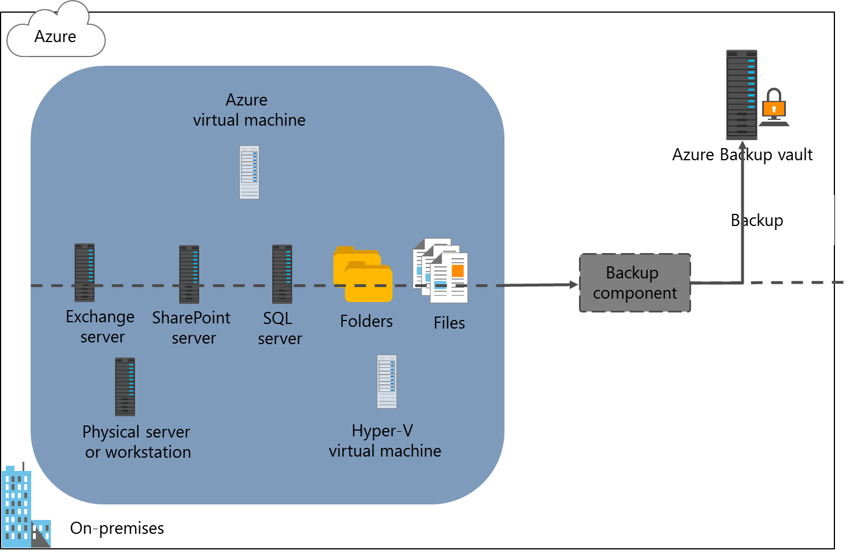
Overview of Azure Backup
Notes:
Explain different options that Azure Backup provides and describe their capabilities.
20533D
6: Planning and implementing storage, backup, and recovery services

Slide 45
File and folder backups with the Recovery Services Agent
Create an Azure Backup vault
Configure vault replication type
Specify the backup goal:
Location of the workload: On-premises
The workload type: Files and folders
Download the vault credentials
Download the Recovery Services Agent
Install the Recovery Services Agent
Register local computer with the vault and set a passphrase
Configure the initial backup type, choose files and folders to back up, and create a backup schedule
Notes:
Point out that the Azure Import/Export service options integrate into the Choose Initial Backup Type page of the Schedule Backup Wizard of the Azure Backup console.
20533D
6: Planning and implementing storage, backup, and recovery services

Slide 46
VM-level backup by using the Azure Backup VM extension
Create an Azure Backup vault
Configure vault replication type
Specify the backup goal:
Location of the workload: Azure
The workload type: Virtual machine
Choose the backup policy
Specify the virtual machines to back up
Notes:
Describe the process of configuring Azure Backup of Azure VMs.
20533D
6: Planning and implementing storage, backup, and recovery services

Slide 47
Integrating Azure Backup with Data Protection Manager and Microsoft Azure Backup Server
Feature | System Center 2016 DPM | Azure Backup Server
Application workloads | Yes | Yes
Tape backup | Yes | No
Integration with System Center suite | Yes | No
System Center licensing required | Yes | No
Deduplication support | Yes | Yes
Notes:
Point out the differences between System Center 2016 DPM and Azure Backup Server.
20533D
6: Planning and implementing storage, backup, and recovery services

Slide 48
Implementing Azure IaaS virtual machine backups
Create an Azure Recovery Services vault
Create a custom backup policy
Register an Azure VM in the Recovery Services vault
Notes:
Demonstration Steps
Create a Recovery Services vault
Start Microsoft Edge, and then sign in to the Azure portal by using the Microsoft account that is the Service Administrator or Co-Administrator of your Azure subscription.
Create a new Azure Recovery Services vault with the following settings:
Name: Demo-RecoveryVault
Subscription: your Azure subscription name
Resource group: create a new resource group named 20533D0602-DemoRG
Location: the same region that you chose when running Add-20533DEnvironment at the beginning of this module
Wait until the vault is created.
Create a custom backup policy
In the Demo-BackupVault Azure Recovery Services vault, from the Getting started with backup blade, specify the following backup goal:
Where is your workload running? Azure
What do you want to backup? Virtual machine
Create a new backup policy with the following settings:
Policy name: DemoBackupPolicy
Backup frequency: Daily 12:00 AM local time
Keep the default values for the other settings. Wait until the operation completes.

Slide 49
Notes:
Register an Azure VM in the Azure Recovery Services vault
From the Recovery Services vault blade, navigate to the Select virtual machines blade, select the Azure VM that was deployed when running Add-20533DEnvironment at the beginning of this module.
Verify that the registration completed successfully by navigating to the Backup items blade of the vault in the Azure portal.
Unregister an Azure VM in the Azure Recovery Services vault and delete the vault
From the Backup items blade of the vault in the Azure portal, stop the backup of the Azure VM with the Delete Backup Data option.
From the Demo-RecoveryVault blade, delete the vault.
Reset the demo environment
Start Windows PowerShell ISE as Administrator, type the following command, and then press Enter:
Remove-20533DEnvironment
When prompted, sign in by using the Microsoft account that is the Service Administrator of your Azure subscription.
If you have multiple Azure subscriptions, select the one you want the script to target.
When prompted for confirmation, type y.
Wait for the script to complete, and then close all open windows.
Note: This script removes resource groups provisioned in the demos and the labs of this module. To avoid any unintended data loss, we recommend that you use an Azure trial pass that was provisioned specifically for this course.
Important: If you find any demo or lab resource groups remaining after the script completes, rerun it or use the Azure portal to manually remove them.
20533D
6: Planning and implementing storage, backup, and recovery services

Slide 50
Planning and implementing Azure Site Recovery
Overview of Azure Site Recovery Planning for Azure Site Recovery Implementing Azure Site Recovery
Notes:
20533D
6: Planning and implementing storage, backup, and recovery services

Slide 51
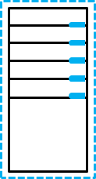
Overview of Azure Site Recovery
On-premises VMware
virtual machines
Azure
Site Recovery Service
Orchestration
only
On-premises
Windows/Linux
physical servers
On-premises Hyper-V
hosts
Orchestration, replication,
failover, and failback
Azure storage,
virtual machines, and network
On-premises
Hyper-V hosts
in VMM clouds
Azure
Site Recovery Service
Notes:
20533D
6: Planning and implementing storage, backup, and recovery services

Slide 52
Planning for Azure Site Recovery
Choose scenario:
Replicating Hyper-V VMs to Azure with VMM
Replicating Hyper-V VMs to Azure without VMM
Replicate VMware virtual machines and physical servers to Azure
Replicate Hyper-V VMs to a secondary datacenter
Replicate Hyper-V VMs to a secondary datacenter with SAN replication
Replicate between on-premises physical servers or VMware virtual machines in primary and secondary datacenters
Replicate Azure VMs between Azure regions
Plan capacity:
Azure Site Recovery Capacity Planner
Hyper-V capacity planning tool
vSphere capacity planning appliance
Identify supported workloads
Notes:
Present planning considerations common across different Azure Site Recovery scenarios, and provide a few considerations that are scenario-specific.
20533D
6: Planning and implementing storage, backup, and recovery services

Slide 53
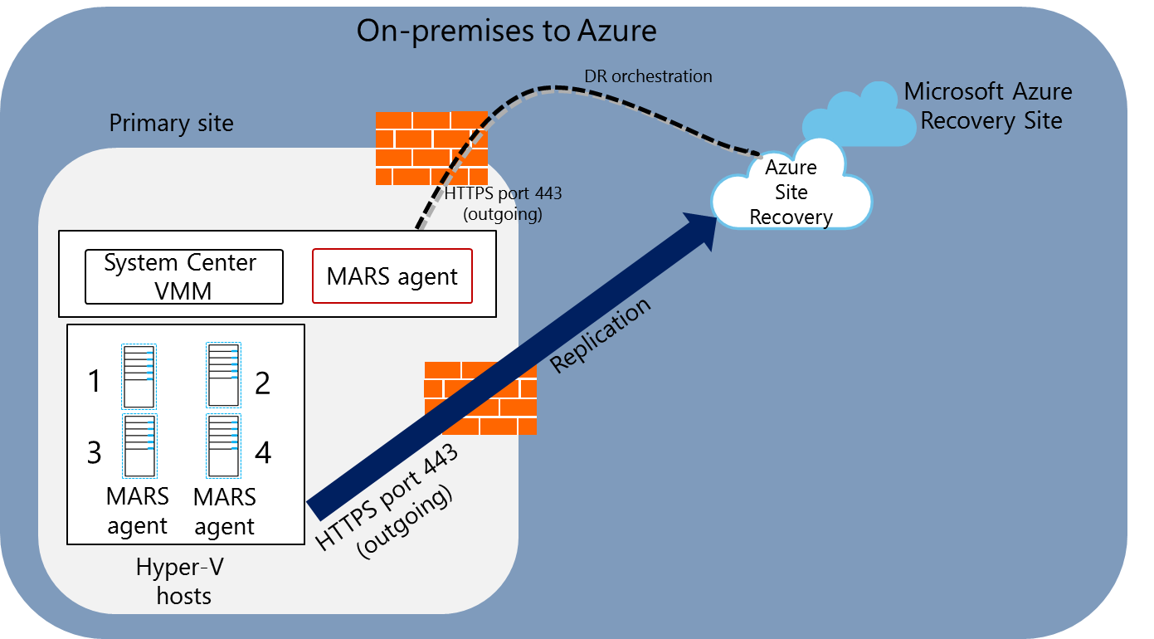
Implementing Azure Site Recovery
Notes:
20533D
6: Planning and implementing storage, backup, and recovery services

Slide 54
https://github.com/MicrosoftLearning/20533-ImplementingMicrosoftAzureInfrastructureSolutions/blob/master/Instructions/20533D_LAB_06.md
Estimated Time: 60 minutes

Slide 55
Active Directory in Azure

Slide 56
Overview of Azure AD
What is AD DS? Implementing AD DS in Azure Overview of Azure AD Active Directory synchronization and Azure AD Demonstration: Creating and managing an Azure AD tenant AD FS and Azure AD
Notes:
10979D
8: Creating and managing Azure AD

Slide 57
What is AD DS?
Serves as a core infrastructure component
Authenticates and authorizes domain users, computers, and Active Directory–aware applications
Stores management data that you can use to control user and computer settings by using Group Policy Objects (GPOs)
Relies on a secure channel with domain member computers established through domain join
Organizes objects into a customizable hierarchy
Extends the scope of authentication and authorization by using forests and trust relationships
Notes:
Depending on the students’ familiarity with AD DS, you might need to expand on some technologies that this topic presents. Make this presentation as interactive as possible, to help you determine whether students need additional clarification. Additionally, you should explain that while this module’s purpose is to focus on Azure AD, it is helpful to understand its on-premises origins. Understanding Active Directory also is helpful, as it eliminates confusion about the differences between AD DS (on-premises) and Azure AD (cloud).
10979D
8: Creating and managing Azure AD

Slide 58
Implementing AD DS in Azure
AD DS was designed for on-premises deployments:
Single-tenant by design
Relies on protocols not suited for Internet communication
Requires domain-joined computers to deliver full functionality
You can install AD DS domain controllers in Azure virtual machines to:
Utilize an AD DS domain that you manage
Utilize a separate AD DS or your on-premises AD DS
You can implement Azure AD DS to:
Utilize a separate AD DS domain that is a managed service
Synchronize with Azure AD and, optionally, with on-premises AD DS
You can leverage AD DS to authenticate and authorize mobile devices and cloud-based services
Notes:
Describe the two primary options for implementing AD DS in Azure, AD DS in Azure virtual machines, and Azure AD DS.
10979D
8: Creating and managing Azure AD

Slide 59
Overview of Azure AD
Microsoft-managed
A platform as a service offering:
Three service and pricing tiers (Free, Basic, Premium P1 and P2)
Multi-tenant by design
Relies on Internet-friendly protocols
Supports users, groups, applications, and devices
No organizational units or computer objects
Does not support Group Policy-based management:
Consider using an MDM solution (such as Microsoft Intune)
No support for forests or trust relationships:
Relies on federations to extend scope of authentication
Notes:
Note: This topic has two slides.
Students might find some of the concepts in this topic difficult to understand, so make this presentation as interactive as possible to determine whether you need to provide additional explanation. Focus on comparing AD DS and Azure AD, but start by briefly reviewing Azure subscriptions and accounts to ensure that students do not confuse them with Azure AD tenants and the corresponding Domain Name System (DNS) domains.
If students have Office 365 experience, they might be familiar with cloud, synchronized, and federated identities. Point out that this module focuses on authentication and authorization of cloud identities.
Mention that Azure AD is capable of authenticating and authorizing access to both cloud-based and on-premises applications.
Describe the four authentication options that Azure AD provides:
Implementing authentication exclusively in Azure AD.
Maintaining an on-premises authoritative source of the identity data in AD DS but synchronizing it to Azure AD at regular intervals.
Taking advantage of Active Directory Federation Services (AD FS) capabilities (which this topic covered earlier) to authenticate users accessing cloud resources.
Relying on pass-through authentication.
10979D
8: Creating and managing Azure AD

Slide 60
Overview of Azure AD
Delegation model within Azure AD tenant:
Several predefined Azure AD roles
Permissions based on users, groups, and applications
Assigned applications automatically accessible via Access Panel
Delegation model within Azure AD subscription:
Role-based access control (RBAC) using Azure AD principals
Predefined and custom roles
Roles assigned on the resource, resource group, or subscription level
Native support for Multi-Factor Authentication
Azure AD identity types:
Cloud identity
Synchronized identity
Federated identity
Notes:
10979D
8: Creating and managing Azure AD

Slide 61
Active Directory synchronization and Azure AD
Directory synchronization tool (AAD Connect) synchronizes objects between AD DS and Azure AD
Password hash synchronization and pass-through authentication with Seamless Single Sign-On minimize password related issues
Federated users scenario:
Uses an STS (For example, AD FS) to perform authentication
Eliminates password related issues (SSO)
Azure AD
AAD Connect Server
Notes:
Describe the four scenarios for using the Azure AD Connect. Most implementations of Azure AD that integrate with an on-premises AD DS use directory synchronization. Directory synchronization significantly reduces the management overhead required to integrate on-premises AD DS with Azure AD.
10979D
8: Creating and managing Azure AD

Slide 62
Creating and managing an Azure AD tenant
Create an Azure AD tenant, assign to it a custom domain, and view the verification DNS records
Associate an Azure AD instance with the current Azure subscription
Create an Azure AD user account
Grant an Azure AD user administrative access to an Azure subscription
Notes:
Review the steps in Lab A for guidance when performing this demonstration.
https://github.com/MicrosoftLearning/10979-MicrosoftAzureFundamentals/blob/master/Instructions/10979D_LAB_08.md

Slide 63
AD FS and Azure AD
AD DS domain controller
6
Federation trust
AD FS
Azure AD
7
10
4
5
9
3
8
2
SaaS application
Client computer
1
11
Notes:
Describe the process of authenticating access to an Azure AD–integrated software as a service (SaaS) application by a federated user.
This is an animation slide with 11 clicks.
The first click depicts the user opening a web browser and sending an HTTPS request to the SaaS application.
The second click depicts the SaaS application determining that the user belongs to an Azure AD tenant. The SaaS application provider redirects the user to the user’s Azure AD tenant.
The third click depicts the user’s browser sending an HTTPS authentication request to the Azure AD tenant.
The fourth click depicts that, if the user’s Azure AD account represents a federated identity, the user’s browser is redirected again to the on-premises federation server.
The fifth click depicts the user’s browser sending an HTTPS request to the on-premises federation server.
The sixth click depicts that, if the user is signed in to the on-premises AD DS domain, the federation server requests the AD DS authentication based on the user’s existing Kerberos ticket. Otherwise, the user is prompted to authenticate with the on-premises AD DS credentials, which the federation server relays to an AD DS domain controller.
The seventh click depicts the AD DS domain controller verifying the authentication request and then sending the successful authentication message back to the federation server.
The eighth click depicts the federation server creating the claim for the user based on the rules defined as part of Active Directory Federation Services (AD FS) configuration. The claims data is placed in a digitally signed security token and forwarded to the user’s browser.
The ninth click depicts the user’s browser forwarding the security token containing claims to Azure AD.
10979D
8: Creating and managing Azure AD
(More notes on the next slide)

Slide 64
Notes:
The tenth click depicts Azure AD verifying the validity of the AD FS security token based on the existing federation trust. It creates a new token for the purpose of accessing the SaaS application and sends it back to the user’s browser.
The eleventh click depicts the user using the Azure AD–issued token to access the SaaS application.
10979D
8: Creating and managing Azure AD

Slide 65
Manage Azure AD authentication
Multi-Factor Authentication Demonstration: Configuring and using Multi-Factor Authentication SSO via Access Panel Demonstration: Configure Password-based SSO
Notes:
10979D
8: Creating and managing Azure AD

Slide 66


Multi-Factor Authentication
Azure Multi-Factor Authentication adds a second level of authentication:
Text message
Phone call
Mobile app
Notes:
Provide the following details to expand the students’ understanding of this topic. By default, Azure AD relies on passwords for user authentication. Microsoft Azure Multi-Factor Authentication adds an extra level of authentication, requiring users to use a text message, a call to an office, a mobile phone, or a smart phone app. You cannot configure Multi-Factor Authentication for users who are using Microsoft accounts.
The range of Multi-Factor Authentication capabilities depends on the Azure AD tier. The capabilities described in this topic are part of the Azure Free tier:
Ability to enable and enforce Multi-Factor Authentication for users who are Global Admins. Multi-Factor Authentication for end users is not supported as part of Azure AD Free tier.
Use of text messages, calls to an office and mobile phone, or a mobile phone app as a second authentication factor.
Support for app passwords for desktop apps.
Default voice messages during verification phone calls.
Azure AD Premium includes additional Multi-Factor Authentication features, such as:
Ability to enable and enforce Multi-Factor Authentication for all Azure AD user accounts.
Azure AD–based Multi-Factor Authentication services to protect on-premises infrastructure and applications, including Active Directory Federation Services (AD FS), Remote Access Server (RAS), or Internet Information Services (IIS)-based apps.
One-time bypass allowing for skipping Multi-Factor Authentication for a single sign in to address legitimate emergencies when users do not have their phones readily available but need to sign in to their apps.
Blocking and unblocking of users, temporarily denying their ability to authenticate via Multi-Factor Authentication.
Customizable caller ID, identifying the number from which verification calls are made.
10979D
8: Creating and managing Azure AD
(More notes on the next slide)

Slide 67
Notes:
Advanced reporting and alerting in the form of security reports and fraud alerts. The alerts allow users to notify their administrators whenever they receive an unauthorized authentication verification call.
Customizable voice messages during verification phone calls.
10979D
8: Creating and managing Azure AD

Slide 68
Configuring and using Multi-Factor Authentication
Enable Multi-Factor Authentication for an Azure AD user account
Authenticate to the Azure portal as an Azure AD user with Multi-Factor Authentication enabled
http://aka.ms/E9ep7z

Slide 69
SSO via Access Panel
Single Sign-On implementations:
Password-based SSO:
Administrator managed credentials
User managed credentials
Azure AD SSO
Linked SSO
Azure AD Access Panel:
Lists all applications assigned to a user
Implements SSO
Relies on Access Panel Extension browser add-on for password-based SSO
Notes:
Point out that the use of password-based single SSO applications from Access Panel requires installation of the Access Panel Extension add-on and enabling it in the browser. Such extensions are available for newer versions of Internet Explorer (starting with Internet Explorer 8), Chrome, and Firefox. Opening an application for the first time triggers its installation.
10979D
8: Creating and managing Azure AD

Slide 70
Configure Password-based SSO
Add a directory application
Assign a directory application to a user
http://aka.ms/R8gc5q

Slide 71
https://github.com/MicrosoftLearning/10979-MicrosoftAzureFundamentals/blob/master/Instructions/10979D_LAB_08.md
Estimated Time: 30 minutes

